Slide 1

Entrepreneur Consulting LLC.
Alicia - Arin - Charleen - Janie - Jose

Slide 2












Meet the Team
Alicia
Arin
Charleen
Janie
Jose
Our Vision
Capabilities Used
To become the premier strategic business planning tool for aspiring & existing entrepreneurs.

Slide 3
Entrepreneur Consulting LLC
Purpose/ Why
Client develops a potential business idea
Client begins business planning process & seeks for resources
Entrepreneur Consulting LLC provides services new/ existing entrepreneurs seeking to grow business through strategic business planning
Services offered
New Entrepreneurs
Existing Entrepreneurs
Applications that will help them develop optimal plan
Ongoing weekly report that provides market landscape update
Machine Learning, Folium, Wordcloud, Leaflet, Plotly, D3
Tableau

Slide 4
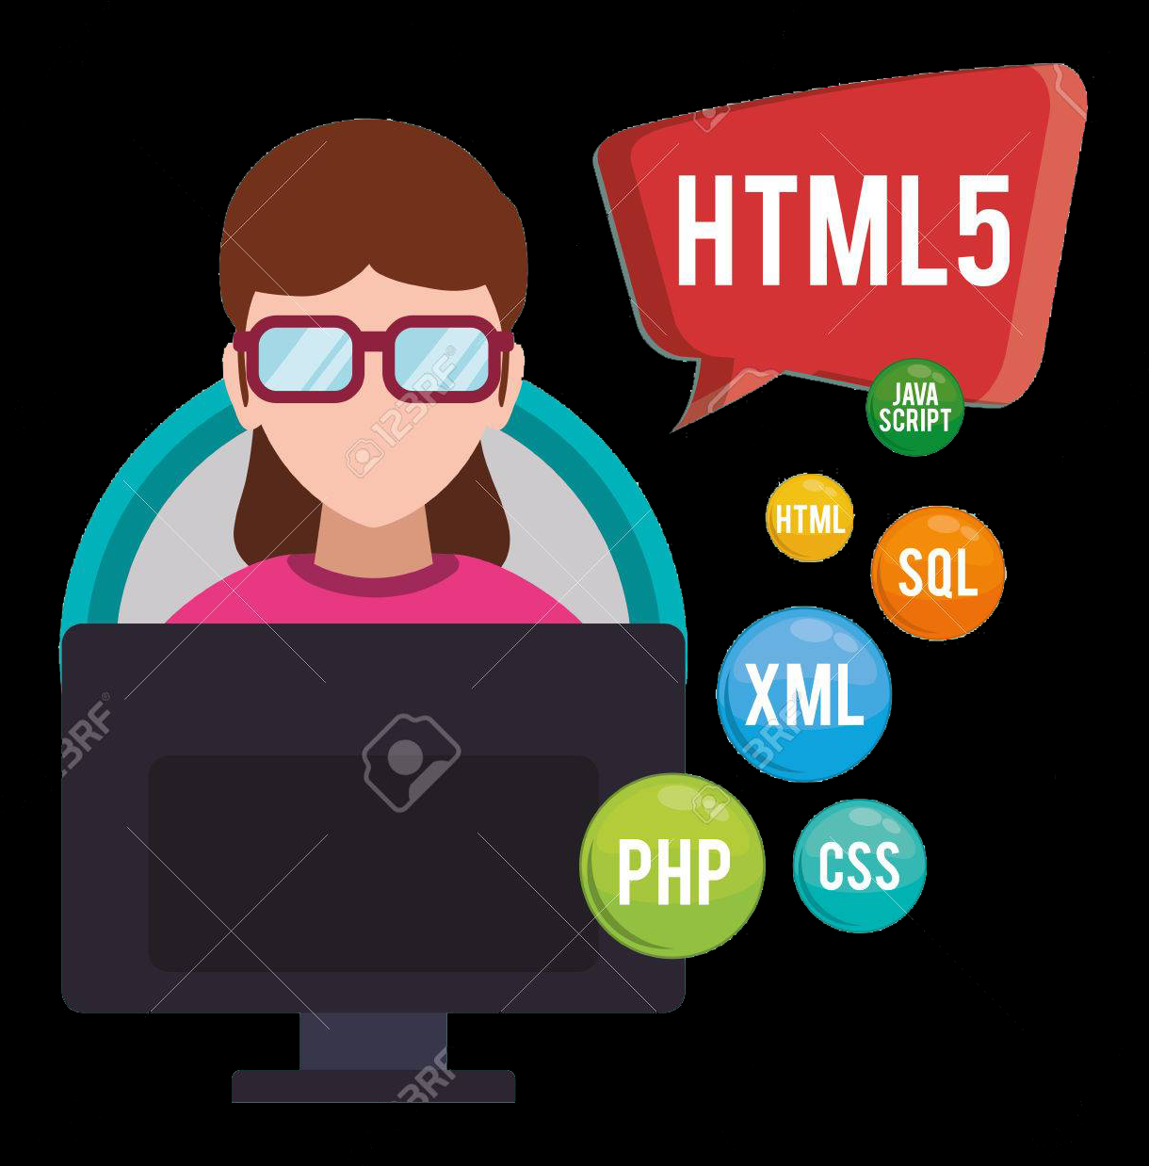

Our Approach
Data Cleansing & Prep
Development

Slide 5





Data Sources
Nielsen Syndicated Data
30,000+ rows of data
650,000+ data points
Three years worth of data
150+ categories by state
Yelp
192,000 business
11 cities
6.9MM Reviews
Sourced from Yelp website
United States Census Bureau
8 years of data
10,000 data points
State level
Demographic, Income, Etc.
Crime Data
45,000 rows of data
Type of crime
Broken out by age, demographic, etc.

Slide 6
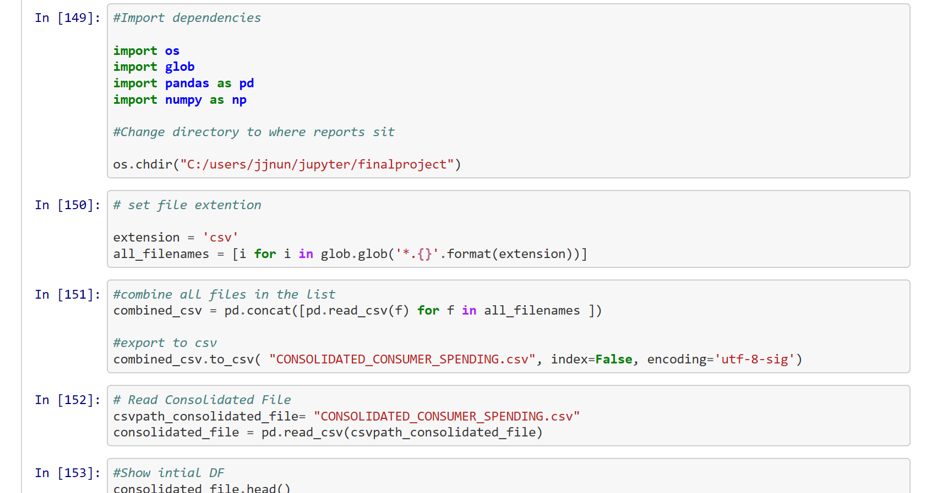
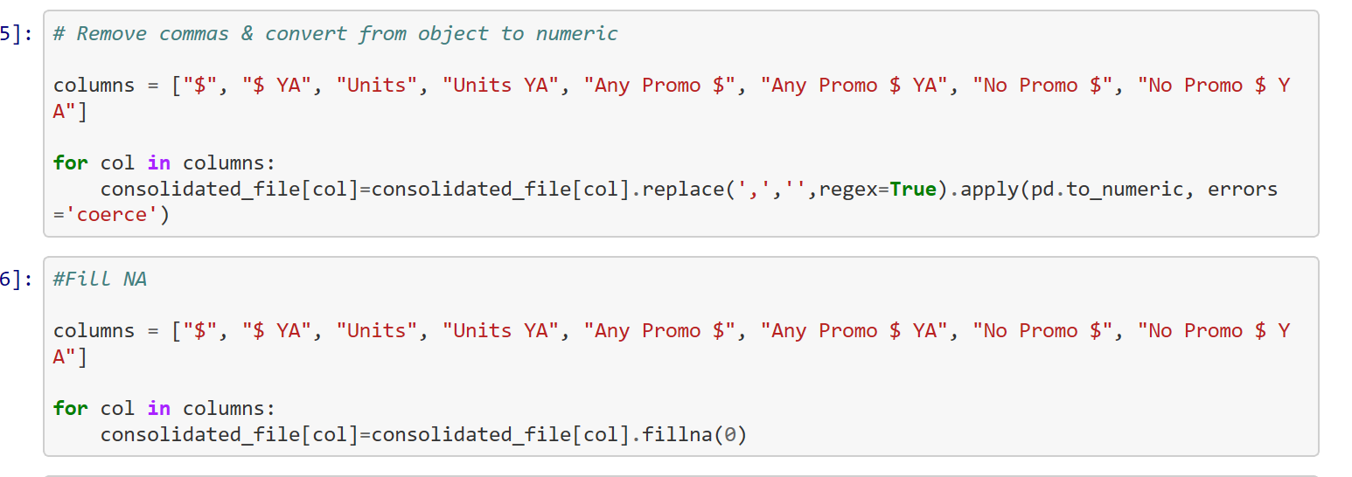
Data Cleansing
Looped through “x” amount of files and consolidated data into 1 file
Removed NaN values from dataset
Created calculations (% Change & Index) versus year ago
Removed formatting

Slide 7
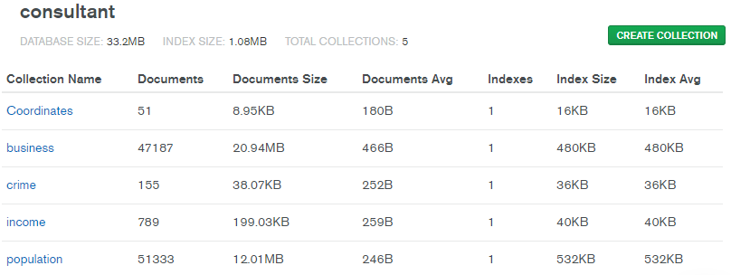
Loading to Database

Slide 8
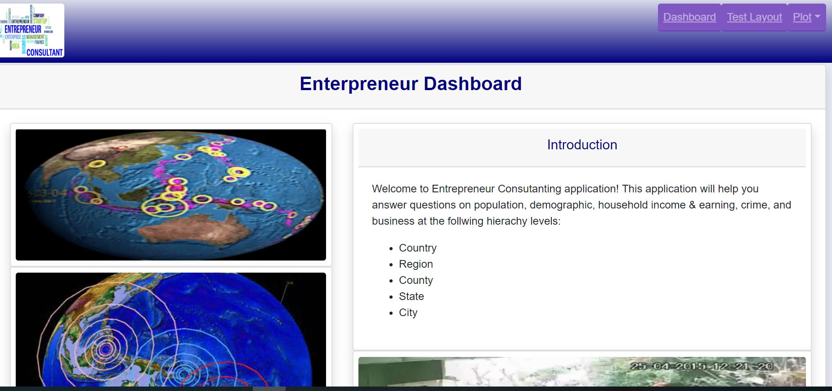
Application

Slide 9
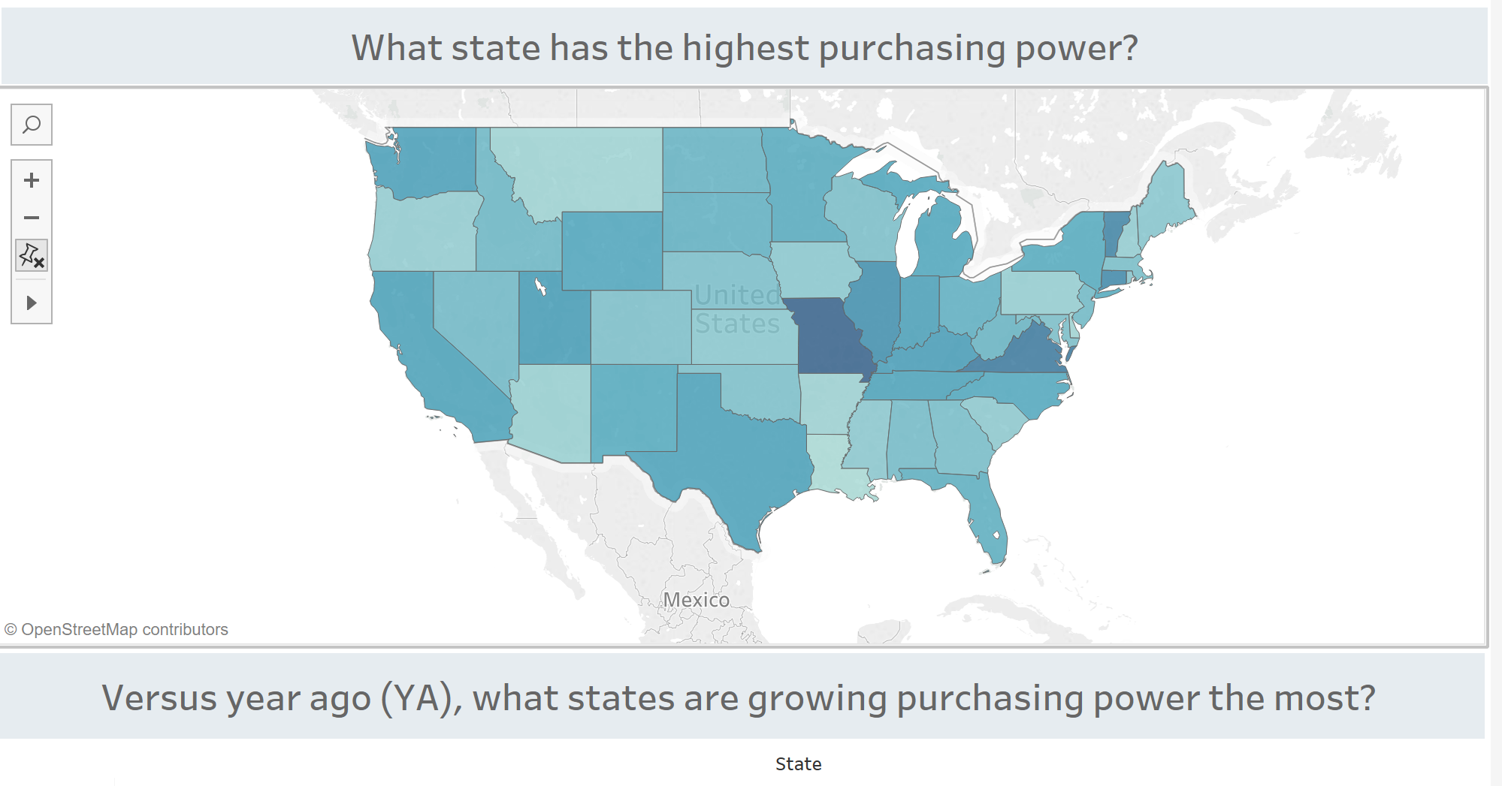
Application (Tableau)

